Slide 1
From Query to Question in One Click:
Suggesting Synthetic Questions to Searchers
Date: 2013/12/04
Author: Gideon Dror, Yoelle Maarek,
Avihai Mejer, Idan Szpektor
Source: WWW’13
Advisor: Jia-ling Koh
Speaker: Chen-Yu Huang

Slide 2
Outline
Introduction
Query-to-question recommendation approach
Template extraction
Generating question candidates
Question feature representation
Learning-to-rank model
Diversifying suggestions
Experiment
Conclusion

Slide 3
Introduction
In Web search, user may remain unsatisfied for several reasons:
The search engine may not be effective enough
Query might not reflect user’s intent
A common solution is for users to turn to Community Question Answering(CQA) sites, and ask for other users to generate the missing content.

Slide 4
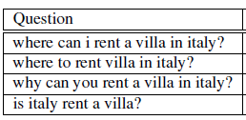
Introduction
Propose to generate synthetic questions that were automatically generate from the searcher’s query.
Searchers can directly post a question in one click on CQA service.
EX: Italy rent villa

Slide 5
Introduction
Specific requirements on the quality of the generated questions
The displayed questions have to be grammatically correct and natural enough to be posted
The list of displayed questions do not include near-duplicates
The list of displayed questions should be as diverse as possible

Slide 6
Outline
Introduction
Query-to-question recommendation approach
Template extraction
Generating question candidates
Question feature representation
Learning-to-rank model
Diversifying suggestions
Experiment
Conclusion

Slide 7
Query-to question recommendation approach
Template extraction
Generating question candidates
Question feature representation
Learning-to-rank model
Diversifying suggestions

Slide 8
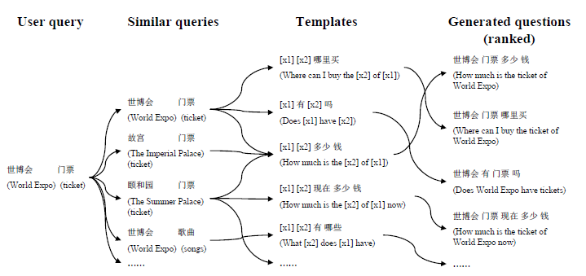
Query-to question recommendation approach
the approach of Zhao et al.

Slide 9
Template extraction
Follow the approach of Zhao et al. and apply the template extraction algorithm on a query/question dataset
Built a dataset consisting of 28 million pairs of (query, question), in which the question originated from Yahoo! Answers, keeping only the title as the question’s text( English queries consisting of 3-5 terms )

Slide 10
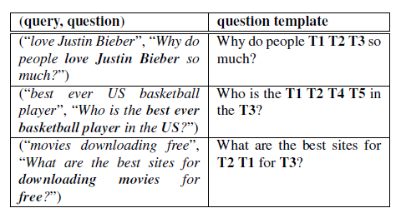
Template extraction
To ensure the quality of the extracted templates, use a simple heuristic, and kept only questions that start with one word that belong to a manually-defined white list(what, who…should, can, is…..)
Templates are extracted by substituting the query terms found in the question

Slide 11
Template extraction
Encode the query term positions part of the variable name
Is T1 taller than T2?
Is T2 taller than T1?
Only templates are associated with at least 10 different queries
40,000 template

Slide 12
Generating question candidates
Use the approach of Zhao et al. in order to select relevant templates
Given a new query q, we fetch all similar queries to produce a set {qi}. For each qi, we fetch the templates tj
Specifically, two queries are considered similar if they count the same number of terms and share at least on term in the same query positions
EX:
fix old car
buy old records
old car repair

Slide 13
Question feature representation
Baseline Features
Likelihood score for the query to instantiate the template behind the general question
A trigram language model score for the question
Combine two feature

Slide 14
Question feature representation
Reranking Features
Question POS language models
Compute the five-gram language model scores for the questions POS tags and for the coarse-POS tags
Should(NNP) I(PRP) fix(VB) my(PRP$) old(JJ) car(NN)
Query POS sequences
Generate binary features representing all the position dependent unigram, bi-gram and tri-gram subsequences with the query tag sequence

Slide 15
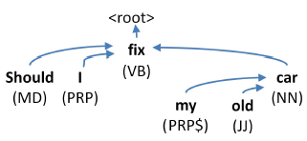
Question feature representation
Reranking Features
Dependency relations
Parse tree score
Provide by the parser to the generated parse tree
Template word order

Slide 16
Learning-to-rank model
Use a linear model for scoring each question vector in the candidate pool
μ :the model weight vector, be trained using the averaged variant of the Passive-Aggressive online learning algorithm
: feature vector of question Q
For training and evaluating ranking model, use a subset of query/question pairs dataset

Slide 17
Diversifying suggestions
As queries are typically underspecified, they can easily represent different intents.
In general, we found that the top-5 recommended questions represent on average only 2-3 different intents.
Integrate diversification into algorithm as a post-process filtering step.

Slide 18
Diversifying suggestions
First-word filter : Impose a different question form, represented by a different interrogative word.
Start with a different word
Edit-distance filter: eliminate redundancy
Two questions are to be redundant if the edit distance between them is lower than a threshold k (k=3)

Slide 19
Outline
Introduction
Query-to-question recommendation approach
Template extraction
Generating question candidates
Question feature representation
Learning-to-rank model
Diversifying suggestions
Experiment
Conclusion

Slide 20
Ranking Evaluation
Experimental setup
Feature in the scoring function : λ = 0.2
Top-k question candidates : k=100
Ranking model training procedure : T = 3

Slide 21
Ranking Evaluation
Manual Evaluation
Randomly sampled 1,000 queries
For each query collected the top three question suggestions
Two metrics : relevance and grammar

Slide 22
Ranking Evaluation
Automatic evaluation
147,000 queries

Slide 23
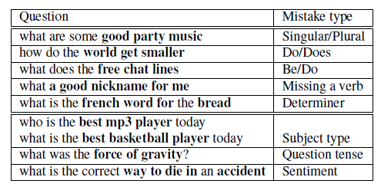
Ranking Evaluation
Manual Evaluation
Most incorrect questions are due to grammatical mistakes
Rare cases of relevance mistakes are more subtle and harder to mitigate

Slide 24
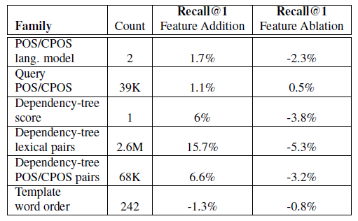
Ranking Evaluation
Feature analysis

Slide 25
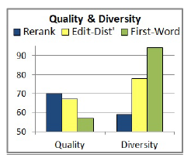
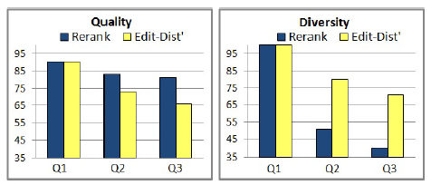
Diversification Evaluation
Filters Comparison
140,000 queries
Measured how many questions were filtered out
Manual Evaluation
50 queries, top-3 questions

Slide 26
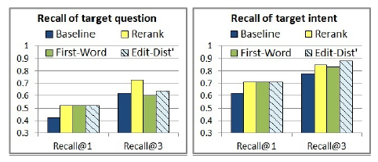
Diversification Evaluation
Automatic Evaluation
A suggested question is considered as matching the target question if it is similar enough to the target question

Slide 27
Outline
Introduction
Query-to-question recommendation approach
Template extraction
Generating question candidates
Question feature representation
Learning-to-rank model
Diversifying suggestions
Experiment
Conclusion

Slide 28
Conclusion
Introduce a new model for synthetic question generation that pays special attention to the eventual grammatical correctness and appeal of the suggestion list.
Use the learning-to-rank framework that leverages millions of features covering both relevance and correctness aspects
Increase the overall appeal of the suggested list by introducing a novel diversification component.
Intent to develop a few use cases and associated treatments, and investigate the reaction of users in an extensive online experiment

